Slide 1
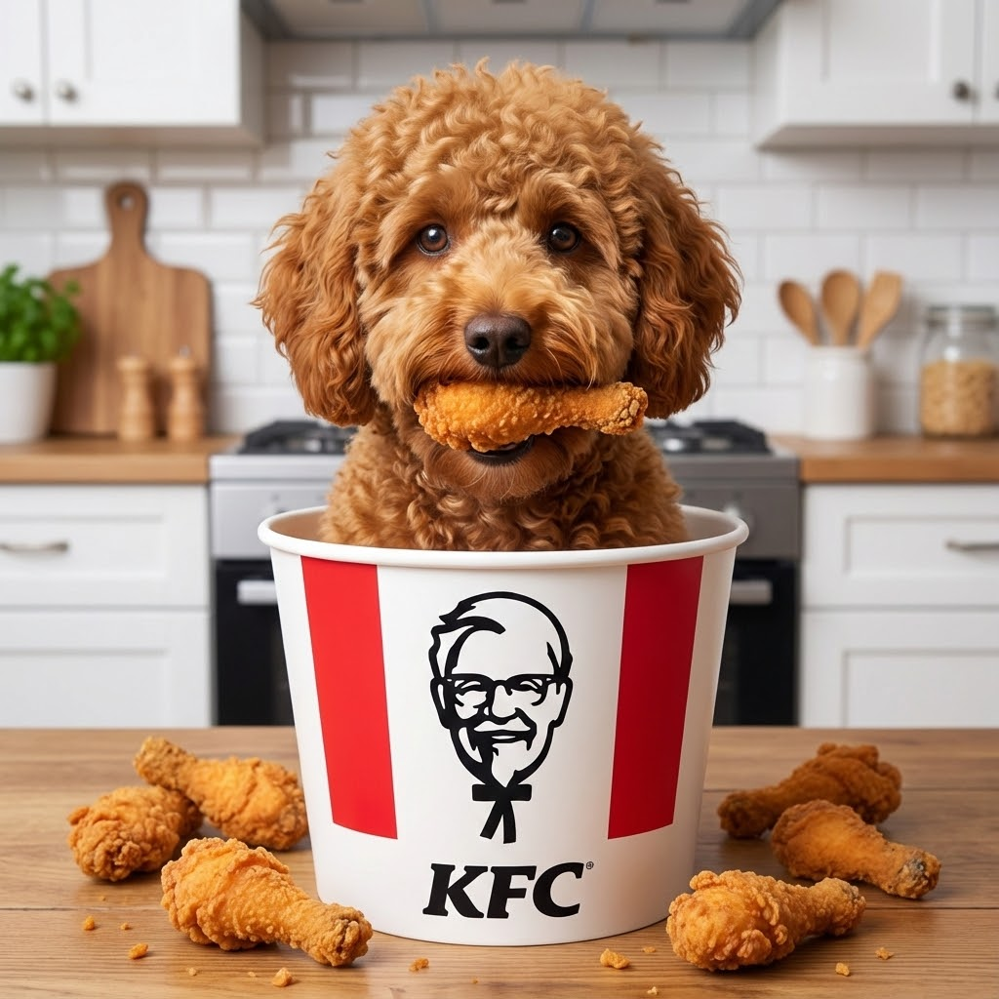
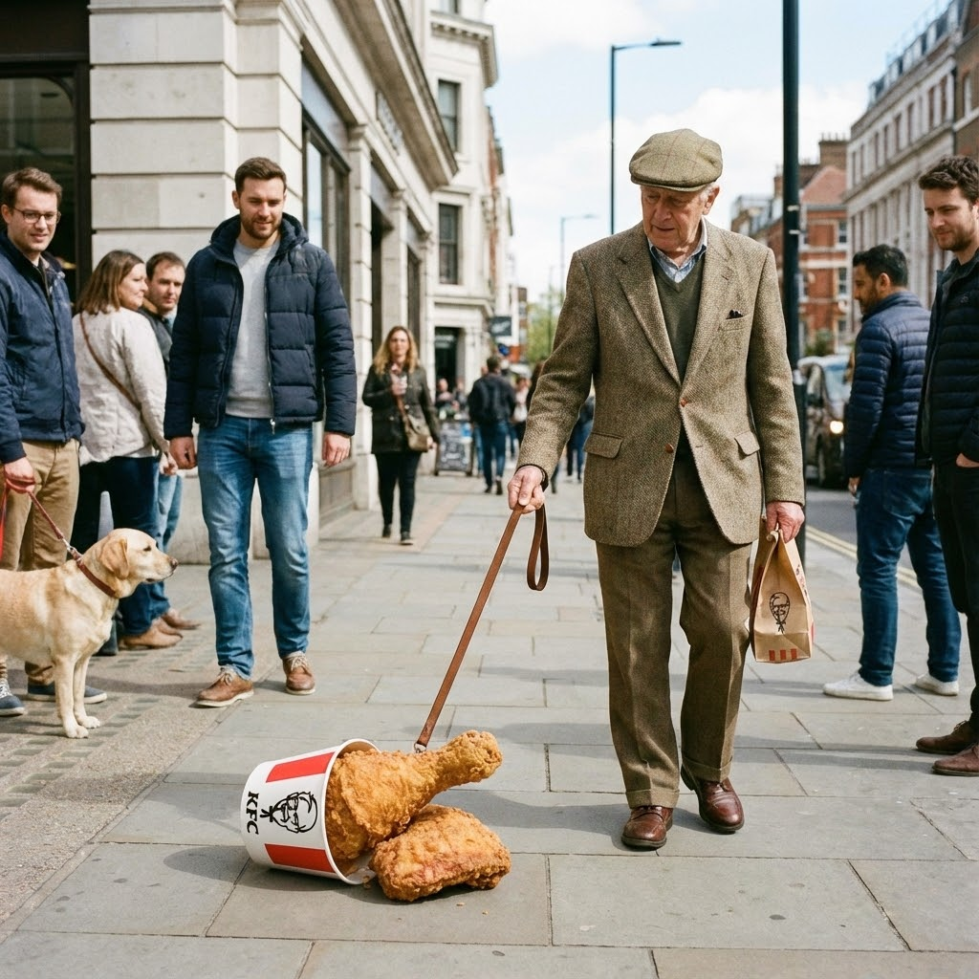
Poodle or Fried Chicken? 🐩🍗
Binary Classification: Poodle vs. Fried Chicken
Deep Learning Exercise 1

Slide 2

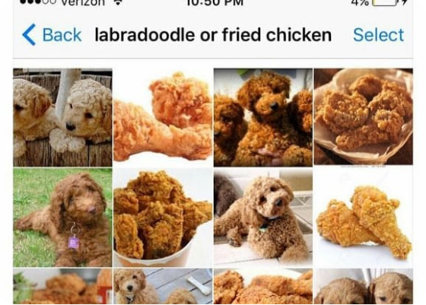

1. The Problem Definition
Goal: Build a binary classifier to distinguish between Poodle dogs and Fried Chicken.
Why this problem?
•
It's a classic Computer Vision meme/challenge.
•
Extreme Visual Similarity: The curly fur of the poodle is texture-identical to the crispy batter of fried chicken.
•
Color Overlap: Both classes share the same golden-brown palette.
•
It tests the model's ability to learn subtle features (eyes, nose) rather than just texture.

Slide 3






2. Data Collection Process
Source
Cleaning
Dataset Size
Images collected using DuckDuckGo Search and Bing Search APIs via python script.
Used verify_images() to remove corrupt files.
~300 Images Total
Split: 80% Train / 20% Valid
0 Corrupt Images Found!

Slide 4
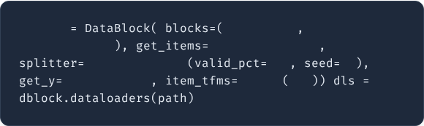
3. The Pipeline
We leveraged the flexible DataBlock API:
•
Inputs: ImageBlock, CategoryBlock
•
Splitter: RandomSplitter (20% validation)
•
Labeling: parent_label (from folder name)
•
Transforms: Resize to 128px (Squish method)
dblock
ImageBlock
CategoryBlock
get_image_files
RandomSplitter
0.2
42
parent_label
Resize
128

Slide 5
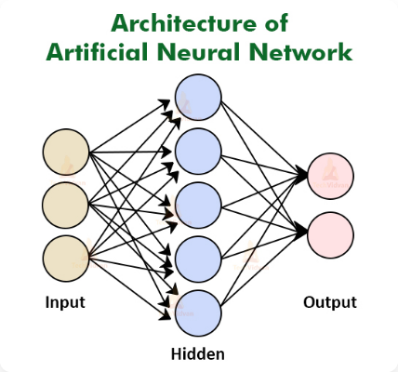
4. Model Architecture & Training
Architecture: ResNet34
We used Transfer Learning. We took a model pre-trained on ImageNet (which already knows how to "see") and fine-tuned it for our specific binary classification task.
Training Process
•
LR Finder: Used to pick the optimal learning rate.
•
Fine Tuning: Used fine_tune(4).
•
Frozen body for 1 epoch, then unfrozen for 4 epochs.

Slide 6
5. Quantitative Results
The model converged rapidly. By the final epoch, we achieved near-perfect accuracy.
epoch | train_loss | valid_loss | error_rate
0 | 0.123849 | 0.226796 | 0.064516
1 | 0.078574 | 0.085828 | 0.016129
2 | 0.055405 | 0.043433 | 0.016129
3 | 0.040465 | 0.020287 | 0.016129
98.4%
1.6%
Final Accuracy
Error Rate

Slide 7
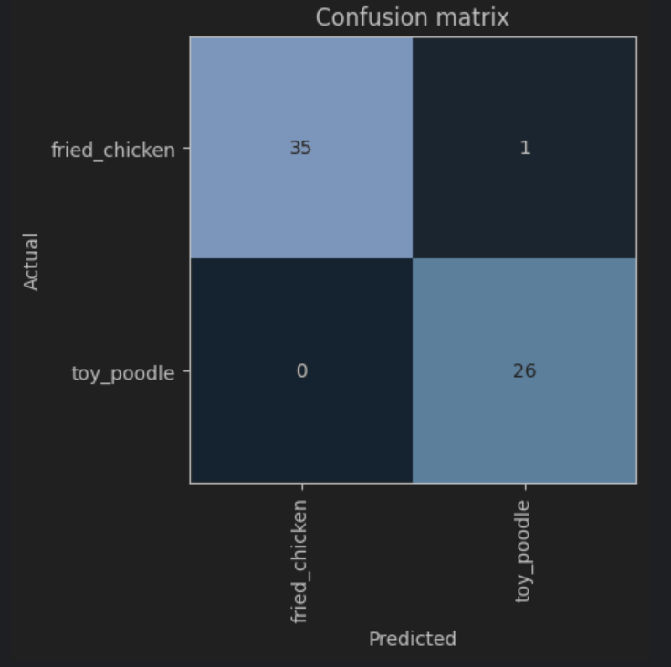
6. Confusion Matrix
Analysis
Out of 62 validation images:
35 Chickens correctly identified.
26 Poodles correctly identified.
Only 1 mistake.

Slide 8




7. Qualitative Analysis
Texture & Features
Some training images had no visible faces. The model successfully learned both subtle texture patterns and distinct features (eyes, nose, tongue).
The Mistake
The single error (Chicken predicted as Poodle) suggests that if a piece of chicken has a shape resembling a silhouette of a dog's head, the model might get confused.

Slide 9
8. Challenges
•
Data Quality: Search results often contain cartoons, memes (like the one in Slide 2), or text overlays which can confuse the model.
•
Overfitting Risk: With a small dataset (~300 images), the model can easily memorize the training data. We used data augmentation to mitigate this.
•
Class Imbalance: We had to ensure we downloaded roughly equal numbers of images for both categories.

Slide 10



Conclusion
Data
Accuracy
Status
Automated & Cleaned
98.4% (ResNet34)
Ready for Inference
Thank you!

